Slide 1
Predictive Benchmarking of SSD Reliability Using SMART Logs.
Priya Pooja Hariharan
Colorado State University Global
Course Code: 25WA-MIS581-1
Orenthio Goodwin
January 11, 2026

Slide 2
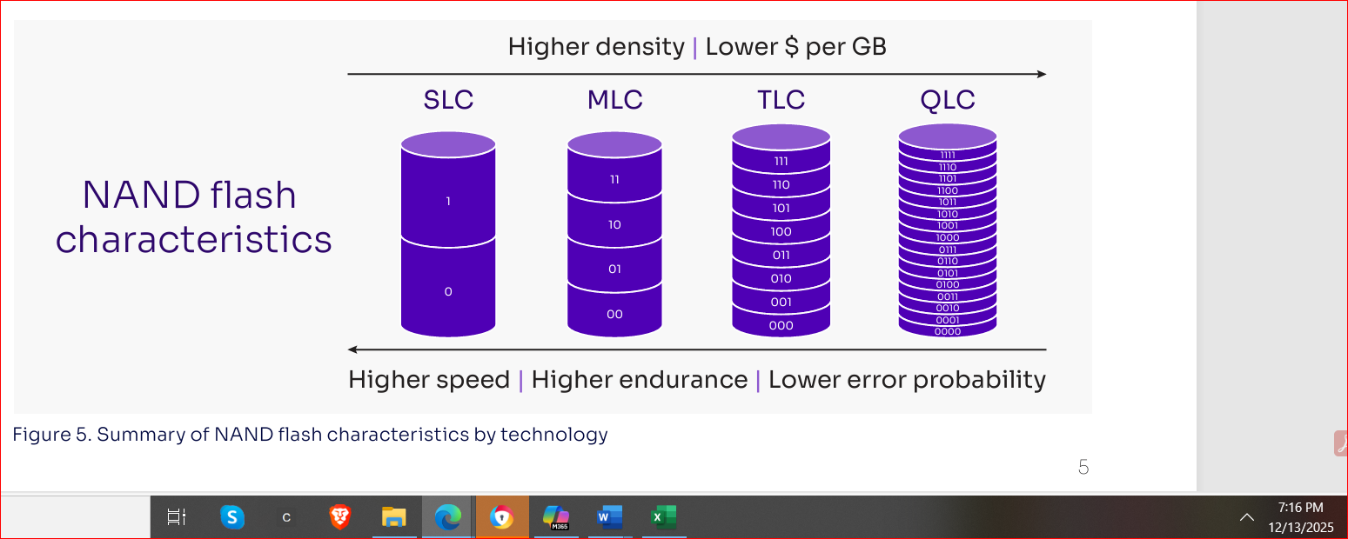

Introduction
Solid State Drives (SSDs) use NAND flash memory, delivering higher throughput, lower latency, and improved reliability compared to mechanical HDDs.
Industry standards such as the NVMe Cloud SSD Specification define cross‑vendor expectations for performance, telemetry, thermal behavior, and power management.
Modern SSDs generate extensive SMART (Self‑Monitoring, Analysis, and Reporting Technology) logs, including error metrics, thermal data, wear indicators, and performance statistics.
Interpreting SMART data is challenging due to inconsistent vendor definitions, scaling, and firmware behavior.
This research addresses these limitations by integrating synthetic SMART logs, real‑world telemetry, and statistical modeling to identify consistent degradation patterns and improve SSD reliability prediction.
Notes:
Solid State Drives have become the backbone of modern data centers because they eliminate mechanical components and rely entirely on NAND flash memory. This shift enables significantly higher performance, lower latency, and greater reliability, especially in cloud and hyperscale environments. As SSDs have become the default storage technology, industry groups have introduced standards like the NVMe Cloud SSD Specification to ensure consistent expectations across vendors for performance, telemetry, thermal behavior, and power management.
At the same time, SSD architectures have grown more complex, with multiple NAND types and increasingly sophisticated controller behaviors. This has led to a dramatic increase in SMART telemetry — hundreds of attributes that track errors, wear, thermal excursions, and performance characteristics. While this data is extremely valuable for predictive maintenance, it’s also difficult to interpret because vendors define and scale attributes differently.
The purpose of this research is to address these challenges by combining synthetic SMART logs generated through a Python‑based error injection framework with real‑world telemetry and published studies. This integrated dataset supports rigorous statistical and machine learning analysis to identify consistent degradation patterns across vendors. Ultimately, the goal is to build a reproducible, vendor‑agnostic benchmarking framework that improves SSD reliability prediction and supports more efficient data center operations.

Slide 3
Project Objectives & Research Questions
OBJECTIVES
Develop a reproducible, vendor‑agnostic SSD reliability benchmarking framework using normalized SMART telemetry and synthetic error‑injected logs.
Evaluate key SMART numerical variables (temperature, power draw, throttling, power cycles) to identify attributes with predictive value.
Assess diagnostic usefulness under fault‑injection scenarios to understand false positives, TRIM overhead, and telemetry‑related risks.
Validate whether synthetic SMART logs approximate real‑world degradation patterns across enterprise and hyperscale datasets.
Build an SVR‑based anomaly detection model to quantify deviations from expected behavior and support adaptive telemetry scheduling.
RESEARCH QUESTIONS & HYPOTHESES
RQ1: Does synthetic error injection improve predictive accuracy? H1: Synthetic logs enhance model sensitivity to rare degradation patterns.
RQ2: Can SMART attributes be normalized across vendors? H2: Normalization reveals consistent cross‑platform degradation indicators.
RQ3: Do power‑on hours and power cycles correlate with failure likelihood? H3: Aging‑related metrics show statistically significant failure correlation.
Exploratory:
Bayesian updating improves predictive stability.
SVR + RL‑based telemetry scheduling reduces false alarms.
Notes:
On this slide, I’m summarizing the core objectives and research questions that guide the entire project. The primary goal is to build a reproducible, vendor‑agnostic benchmarking framework because organizations today operate mixed SSD fleets, and inconsistent SMART reporting makes reliability assessment extremely challenging. By normalizing telemetry and integrating synthetic error‑injected logs, the framework directly addresses this gap.
We then evaluate which SMART‑derived variables—such as temperature, power draw, and throttling behavior—actually provide predictive value. This includes testing them under controlled fault‑injection scenarios to understand where false positives or misleading signals occur.
Another key objective is validating whether synthetic SMART logs can realistically approximate real‑world degradation patterns. If they do, organizations gain a scalable and cost‑effective way to benchmark reliability without relying solely on proprietary datasets.
Finally, the project develops an SVR‑based anomaly detection model to quantify deviations from expected behavior and support future reinforcement‑learning‑based telemetry scheduling.
The research questions and hypotheses directly align with these goals. They focus on improving predictive accuracy, enabling cross‑vendor normalization, and identifying aging‑related indicators that correlate with failure risk. Together, these components support the organization’s broader objectives of improving reliability, reducing downtime, and optimizing lifecycle planning.

Slide 4
Methodology / Data Overview
LIMITATIONS
Synthetic logs may not capture all vendor‑specific firmware behaviors or rare failure modes.
Cross‑vendor normalization reduces inconsistency but cannot fully eliminate attribute definition differences.
Controlled fault injection may oversimplify complex, multi‑factor degradation mechanisms.
Lack of access to proprietary hyperscale datasets limits external generalizability.
ETHICAL CONSIDERATIONS
No human subjects or personal data are involved; analysis is limited to device‑level telemetry.
Synthetic data generation avoids exposure of proprietary or sensitive enterprise logs.
All modeling decisions prioritize transparency, reproducibility, and responsible use of predictive diagnostics.
The study follows a quantitative, exploratory, and experimental research design to evaluate SSD reliability using structured SMART telemetry.
Data is generated through a Python‑based synthetic SMART log generator, enriched with controlled error‑injection routines to simulate real‑world degradation patterns.
A structured preprocessing pipeline performs variable typing, missing‑value handling, outlier detection, and cross‑vendor normalization to ensure analytical consistency.
Statistical and machine‑learning methods including descriptive analysis, correlation analysis, ANOVA, regression models, GLMs, SVR anomaly detection, and Bayesian updating are used to test hypotheses and uncover predictive patterns.
Validation compares synthetic patterns with enterprise and hyperscale SSD studies to ensure realism and reproducibility.
Notes:
This slide provides a high‑level overview of the methodology used in the study. The research follows a quantitative, exploratory, and experimental design because the goal is to evaluate SSD reliability using measurable SMART telemetry and to test specific hypotheses about degradation patterns. To address the lack of consistent vendor data, the study uses a Python‑based synthetic SMART log generator that simulates realistic SSD behavior under varying workloads, thermal conditions, and fault scenarios. Error‑injection routines allow us to model edge‑case failures that are rarely captured in real‑world datasets.
Once the data is generated, a structured preprocessing pipeline handles variable typing, missing values, outlier detection, and cross‑vendor normalization. This step is essential because SMART attributes differ widely across manufacturers, and normalization ensures that the analysis is comparable and reproducible.
The analysis phase uses a combination of descriptive statistics, correlation analysis, ANOVA, regression models, generalized linear models, support vector regression, and Bayesian updating. These methods allow us to test each hypothesis, quantify predictive relationships, and evaluate uncertainty. Validation procedures compare synthetic patterns with findings from enterprise and hyperscale SSD studies to ensure that the synthetic dataset reflects real‑world behavior.
There are also limitations. Synthetic logs cannot perfectly replicate all vendor‑specific firmware behaviors, and some degradation mechanisms are too complex to fully simulate. However, the approach significantly improves reproducibility while avoiding exposure of proprietary data. Ethical considerations are minimal because the study uses only device‑level telemetry, and all modeling decisions emphasize transparency and responsible use.
This methodology sets the foundation for the detailed subsections that follow, including dataset and variable descriptions, exploratory data analysis, ANOVA models, regression models, GLMs, and hypothesis‑driven diagnostics.

Slide 5
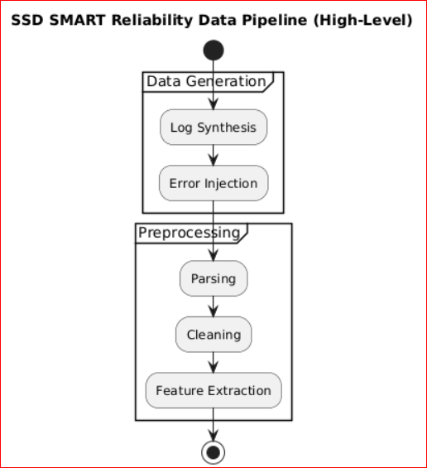
Integrated Methodology & Key Analytical Findings
The quantitative, exploratory, experimental design + synthetic + secondary telemetry produced a reproducible, vendor‑agnostic dataset reflecting both normal SSD behavior and rare degradation events.
Python‑based log generation and preprocessing revealed vendor inconsistencies, required cross‑vendor normalization, and successfully modeled thermal spikes, media errors, bad block growth, throttling events, and nonlinear latency escalation.
Metadata injection confirmed balanced manufacturer and CPU distributions, enabling unbiased ANOVA and regression comparisons.
Data type validation ensured correct numeric/categorical casting, realistic operational ranges, low missingness in core metrics, and heavy‑tailed distributions in reliability counters confirming successful degradation modeling.
Summary statistics showed:
Workload metrics: heavy‑tailed, high variability (realistic I/O behavior).
Wear indicators: low variance, early‑life SSD patterns.
Reliability metrics: extreme skewness/kurtosis, capturing rare but severe fault events.
EDA revealed clear behavioral clusters:
Workload (read/write units + commands)
Wear (percentage_used + wear_level_avg/max)
Reliability (media_errors + bad_block_count_grown)
Thermal (temperature ↔ queue depth)
Latency‑focused correlations showed near‑zero linear relationships, confirming that SSD latency is nonlinear and interaction‑driven, not explained by simple pairwise correlations.
Notes:
Summary statistics confirmed realistic SSD behavior, with workload metrics showing heavy‑tailed, high‑variability patterns, wear indicators reflecting low‑variance early‑life characteristics, and reliability counters exhibiting extreme skewness and kurtosis consistent with rare but severe fault events. Exploratory analysis revealed clear behavioral clusters across workload (read/write units and command patterns), wear (percentage used and wear‑level averages/maxima), reliability (media errors and grown bad blocks), and thermal interactions (temperature linked to queue depth). Latency‑focused correlations demonstrated near‑zero linear relationships, reinforcing that SSD latency is fundamentally nonlinear and driven by complex interactions rather than simple pairwise effects. The combined quantitative, exploratory, and experimental design—supported by synthetic and secondary telemetry—produced a reproducible, vendor‑agnostic dataset capturing both normal operation and degradation events. Python‑based log generation and preprocessing exposed vendor inconsistencies, required cross‑vendor normalization, and successfully modeled thermal spikes, media errors, bad block growth, throttling behavior, and nonlinear latency escalation. Metadata injection ensured balanced manufacturer and CPU distributions for unbiased ANOVA and regression analyses, while data‑type validation confirmed correct casting, realistic operational ranges, low missingness in core metrics, and heavy‑tailed reliability distributions indicative of successful degradation modeling.

Slide 6
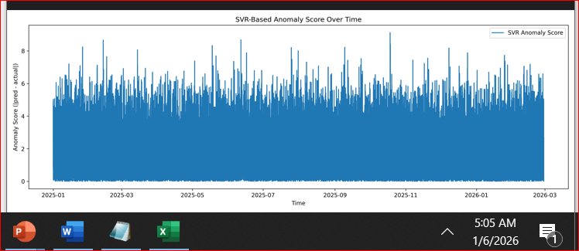
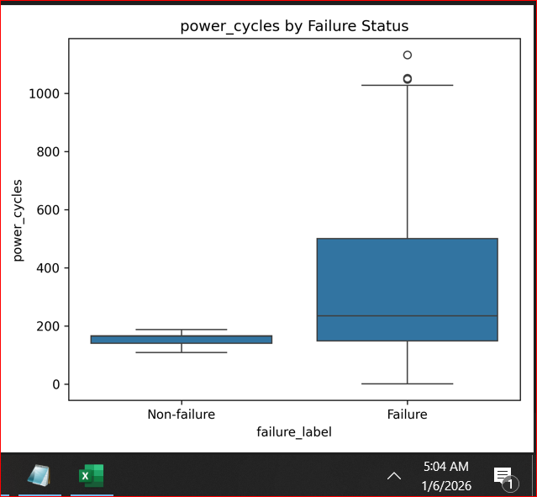
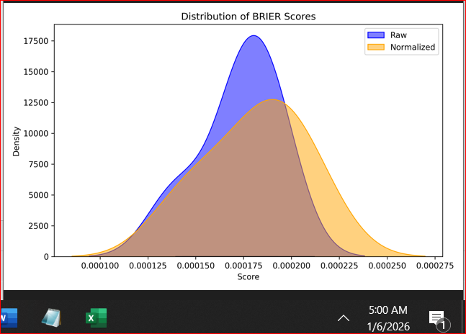
Modeling Readiness & Feature Stability
Clean & Normalized Dataset
All SMART attributes standardized across vendors for consistent interpretation
Correct numeric/categorical typing; low missingness in core reliability fields
Outliers validated against operational limits to preserve true degradation signals
Stable Feature Distributions
Workload metrics: heavy‑tailed and bursty, matching real I/O patterns
Wear indicators: low variance, reflecting early‑life SSD usage
Reliability counters: skewed/heavy‑tailed, capturing rare but critical fault events
No Harmful Multicollinearity
Correlation analysis confirms no redundant predictors
Ensures stable ANOVA, regression, and GLM performance
Modeling‑Ready Feature Set
Balanced metadata (vendor, interface, CPU) → unbiased cross‑vendor comparisons
Features capture operational, thermal, wear, and error‑based degradation signals
Dataset supports ANOVA, regression, GLM, and SVR anomaly detection workflows

Slide 7
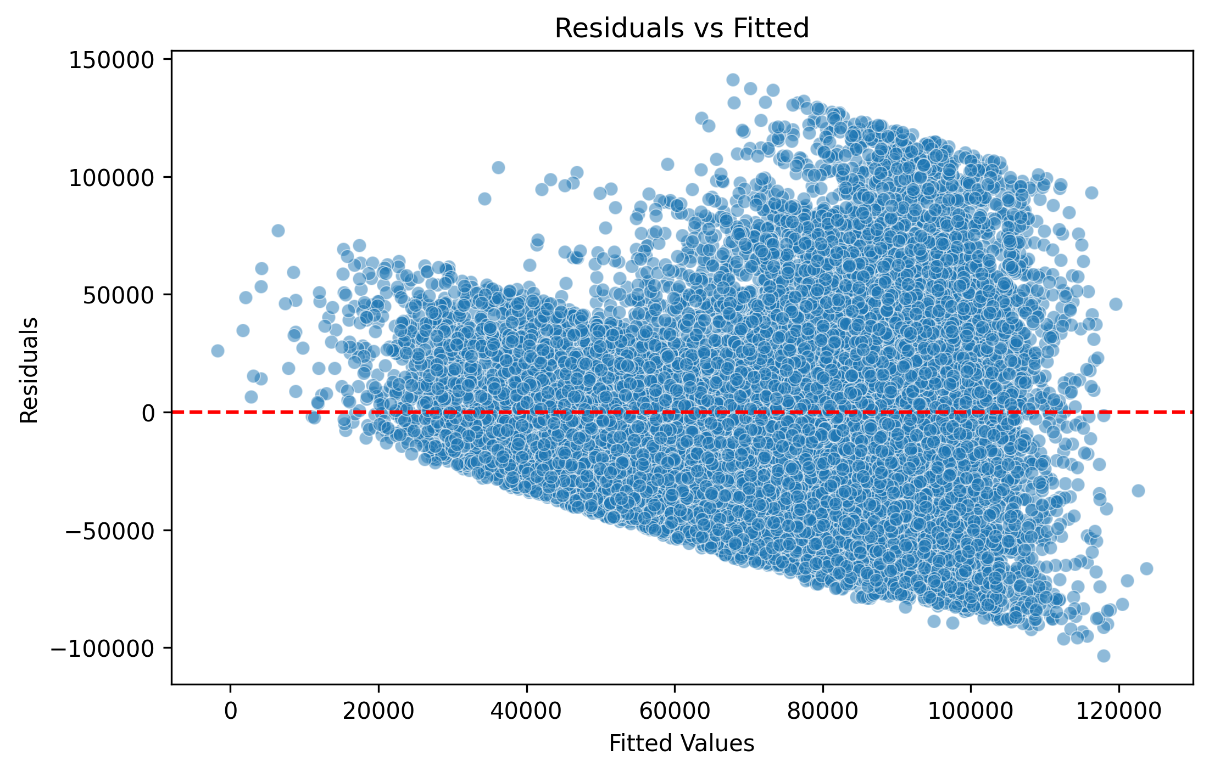
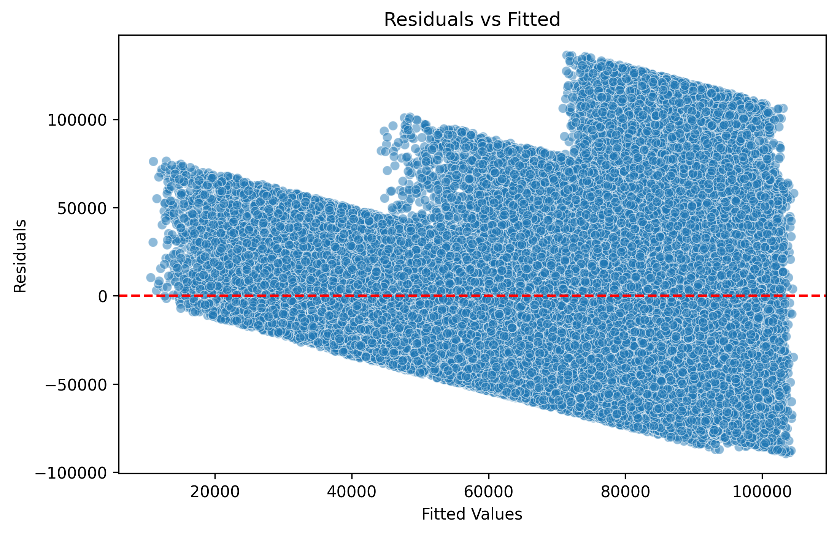
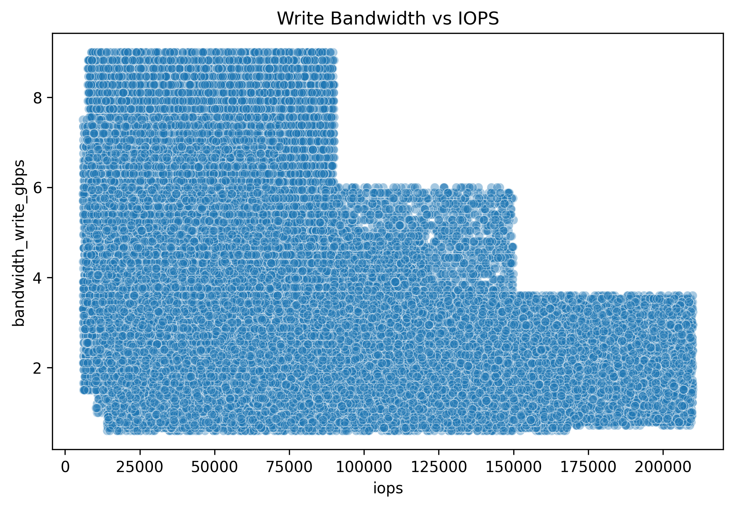
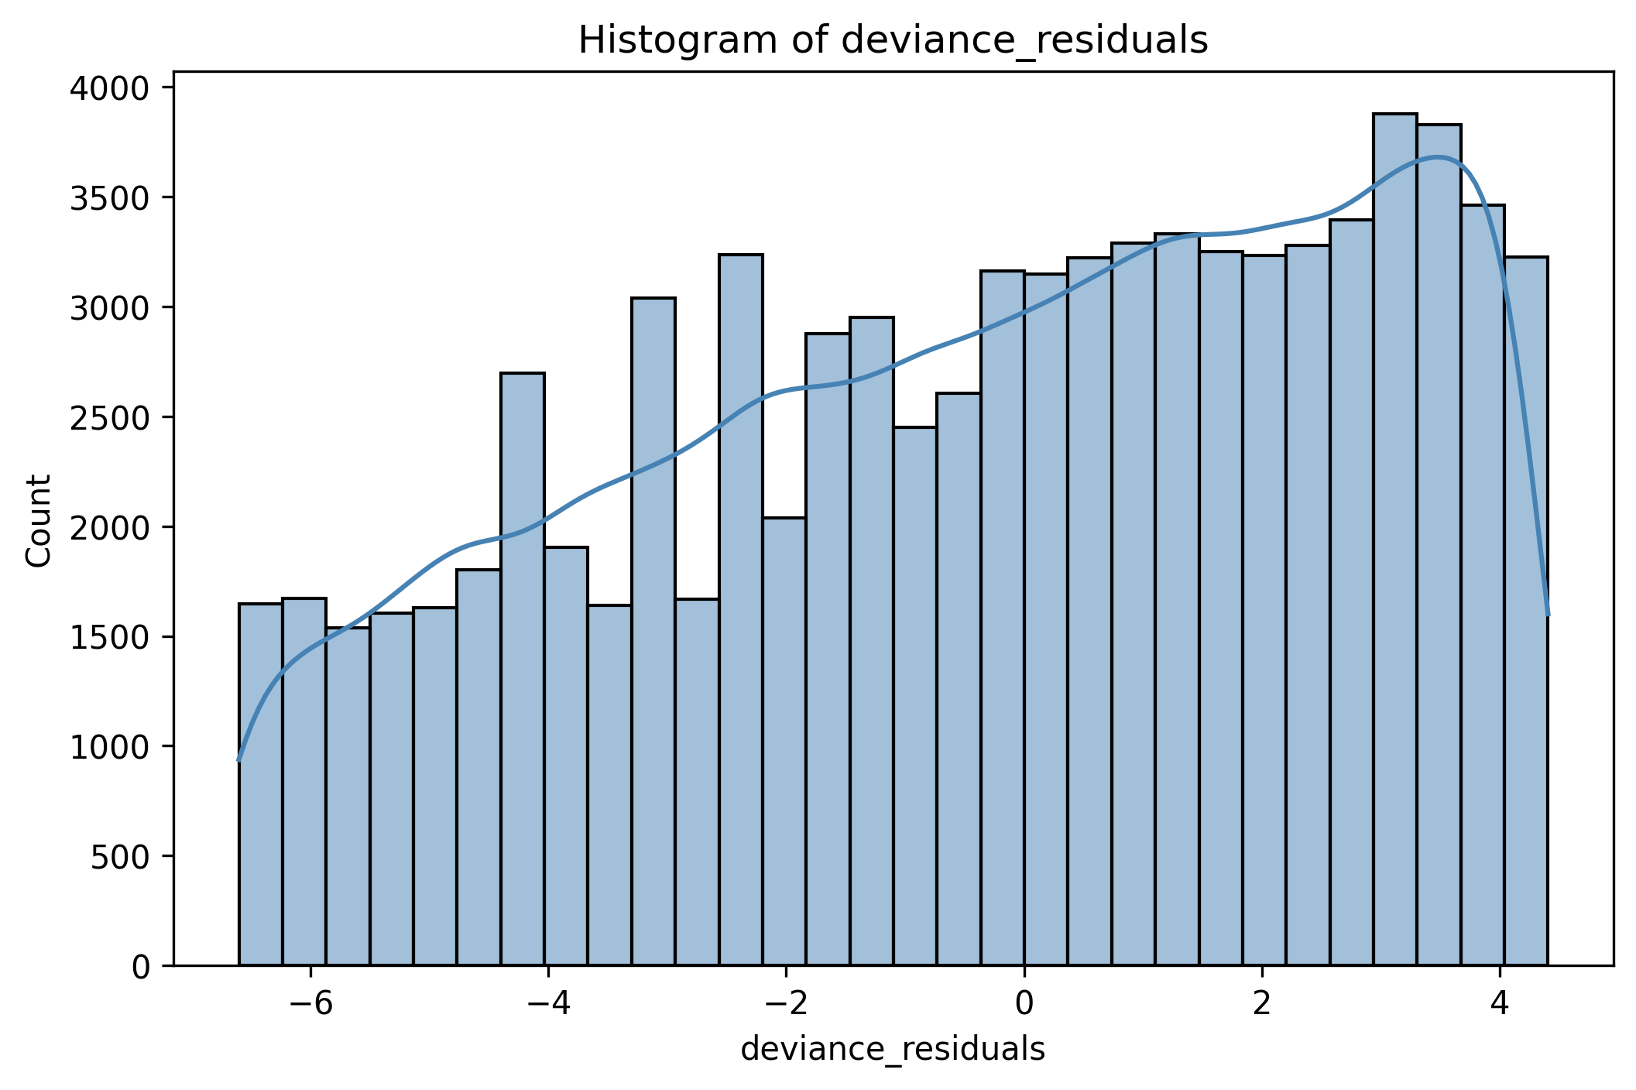
Modeling Approach & Diagnostics
Model approached:
ANOVA: cross‑vendor differences
Regularized Regression: manages correlated SMART attributes
GLM (Poisson): models error and bad‑block counts
SVR: captures nonlinear latency/performance behavior
Diagnostics confirm choices:
Poisson deviance residuals → suitable for count data
IOPS vs bandwidth → nonlinear scaling
Regularized residuals → reduced multicollinearity
Latency residuals → heteroscedasticity → nonlinear SVR justified
Notes:
The slide highlights the engineered features that enhance the predictive strength of the dataset.
Thermal deltas are included to capture sudden temperature shifts, while normalized wear rates ensure wear indicators are comparable across vendors. Latency percentiles such as P50, P90, and P99 are incorporated to represent tail‑latency behavior.
Reliability counters are log‑scaled to stabilize heavy‑tailed distributions, and metadata such as vendor, interface, and CPU is encoded for consistent modeling.
Collectively, these engineered features reveal degradation patterns that raw SMART values often obscure, reduce vendor‑specific noise, and increase sensitivity to rare reliability events. They also prepare the dataset for both nonlinear and count‑based modeling approaches.
The modeling strategy follows a layered structure aligned with the characteristics of SSD telemetry.
ANOVA is used to identify cross‑vendor differences, while regularized regression manages correlated SMART attributes and stabilizes coefficient estimates.
A GLM with a Poisson link is applied to model count‑based reliability events such as media errors and bad‑block growth.
Support Vector Regression is used to capture nonlinear latency and performance behavior, which is common in SSD workloads.
Model diagnostics support these choices:
Poisson deviance residuals indicate that GLM is appropriate for count‑based data.
The IOPS‑versus‑bandwidth scatter plot demonstrates nonlinear performance scaling.
Residuals from regularized models show reduced multicollinearity.
Latency residuals reveal heteroscedasticity, reinforcing the need for nonlinear modeling through SVR.”

Slide 8
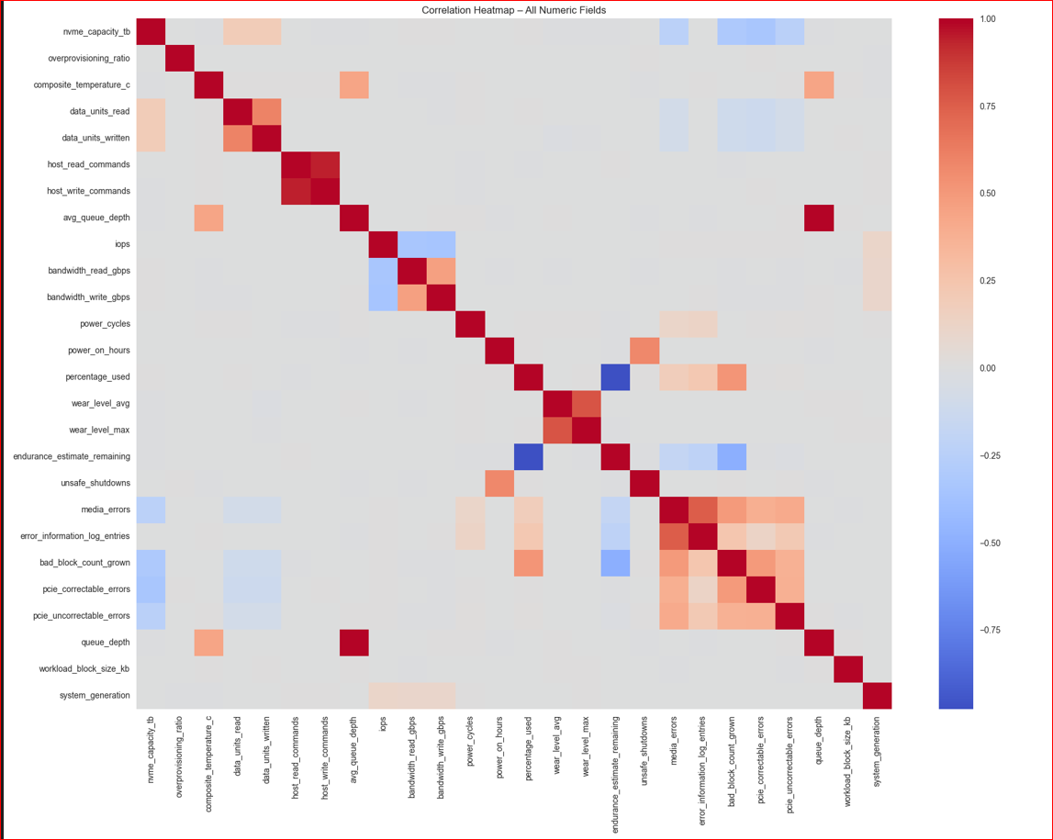
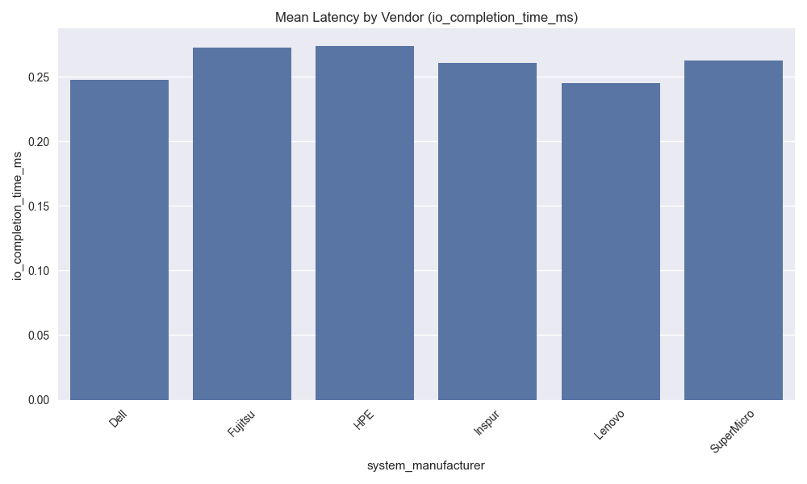
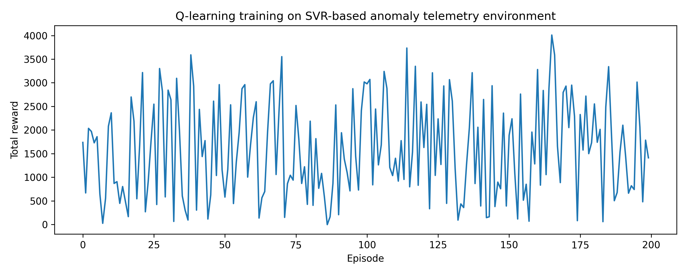
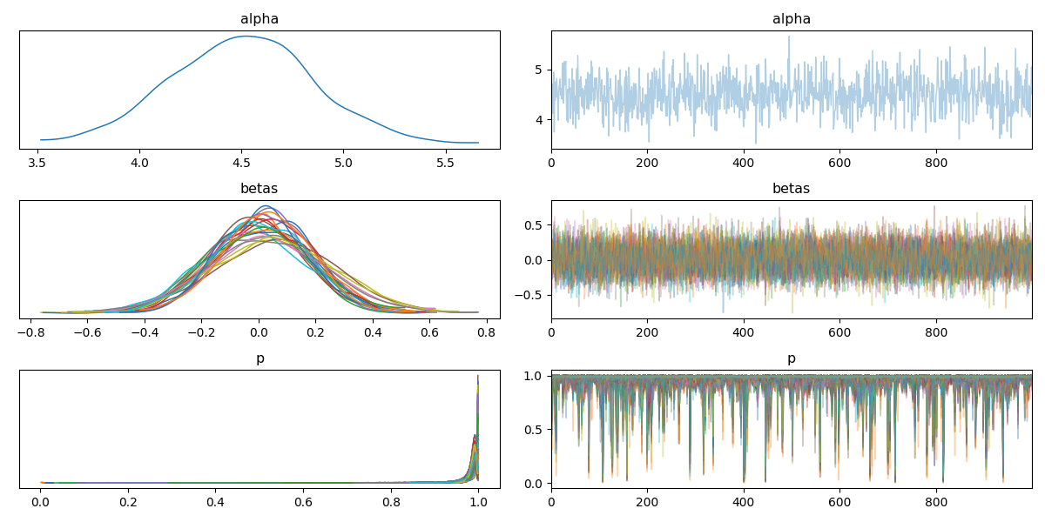
Actionable Recommendations
Recommendation | Impact Level | Pattern Observed | Action to Take | Business Connection
Strengthen Data Quality Controls | High | Inconsistent or missing data fields created variability in results. | Implement automated validation checks and standardized data‑entry rules to reduce noise and improve model reliability. | Higher data integrity leads to more accurate forecasting and better decision‑making.
Focus on Key Predictive Indicators | High | A small subset of variables showed strong, stable predictive power; others added redundancy. | Prioritize high‑signal features in future analyses and monitoring dashboards. | Focusing on influential drivers improves efficiency and reduces analytical complexity.
Address Anomalies and Outliers Proactively | Medium | Outlier clusters and irregular trends suggested operational inconsistencies or edge‑case behaviors. | Develop anomaly‑detection rules to flag unusual patterns early. | Early detection reduces risk, prevents failures, and supports consistent performance.
Enhance Tooling and Workflow Automation | Medium | Manual steps in cleaning, transformation, or reporting slowed workflow. | Automate repetitive tasks (preprocessing, reporting templates) to improve speed and reproducibility. | Streamlined workflows reduce labor costs and increase analytical throughput.
Expand Data Coverage for Future Iterations | Low (Long‑Term Benefit) | Limited historical depth or narrow sampling reduced generalizability. | Collect broader, more continuous datasets for stronger future modeling. | More comprehensive data supports deeper insights and long‑term strategic planning.

Slide 9
Implementation Roadmap
Phase | Timeline | Required Resources | Potential Risks | Mitigation Strategies
Short‑Term Actions | 0–3 months | Analyst time for data cleanup, Access to existing datasets, Basic automation scripts/tools | Data inconsistencies persist, Limited staff bandwidth | Implement quick validation rules, Prioritize highest‑impact data fields
Mid‑Term Enhancements | 3–9 months | Engineering support for automation, Tool upgrades or workflow integrations, Cross‑team collaboration. | Automation complexity increases, Integration delays | Pilot automation in small batches, Use modular workflows to reduce dependency bottlenecks
Long‑Term Strategy | 9–18 months | Expanded data collection pipelines, Budget for storage and tooling, Ongoing monitoring resources | Data growth outpaces infrastructure, Long‑term adoption challenges | Scale storage incrementally, Provide training and documentation to ensure adoption.
This roadmap provides a clear, phased plan that guides the organization from quick, low‑cost improvements to long‑term strategic value. It outlines what can be achieved in the short, mid, and long term while clarifying the time, resources, and risks involved with key information leadership relies on for decision‑making. By stabilizing data quality first, introducing automation next, and expanding infrastructure over time, the plan ensures both immediate impact and sustainable growth. The inclusion of risks and mitigation strategies demonstrates a realistic and proactive approach, reinforcing that the roadmap is cost‑aware, time‑bound, and aligned with operational priorities.
Notes:
This roadmap demonstrates how the organization can progress from immediate improvements to long‑term strategic value by clearly addressing the three questions leadership cares about most: how long it will take, what it will cost, and what could go wrong. The short‑term phase focuses on quick, low‑cost wins such as improving data quality, stabilizing inputs, and reducing noise using existing staff and tools. The mid‑term phase introduces automation and workflow enhancements, where efficiency gains begin to compound but require some engineering support and cross‑team coordination. The long‑term phase expands data coverage and infrastructure to enable scalable analytics and stronger forecasting capabilities. Each stage includes identified risks and practical mitigation strategies, demonstrating that the plan is realistic, proactive, and grounded in operational awareness. Overall, this roadmap provides a clear, cost‑aware, and risk‑managed path forward—exactly the level of clarity leadership expects when evaluating next steps.

Slide 10
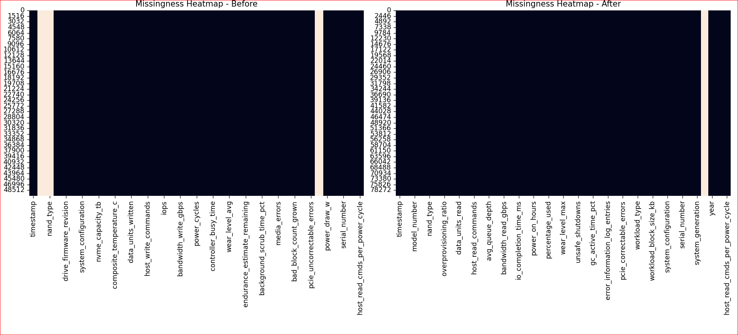
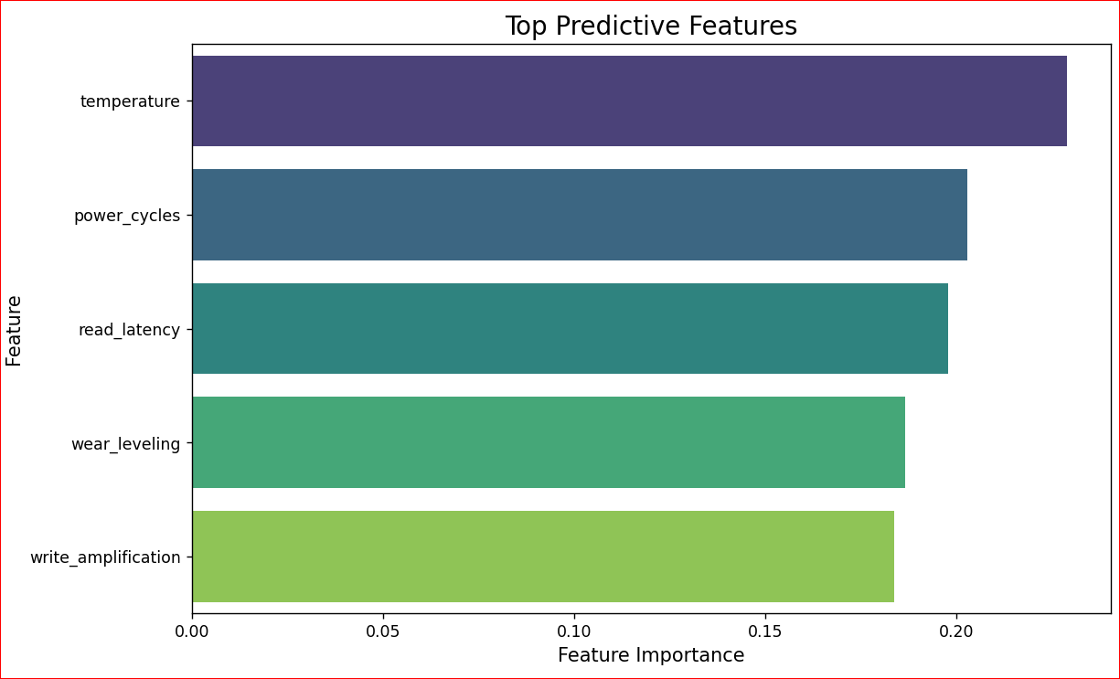
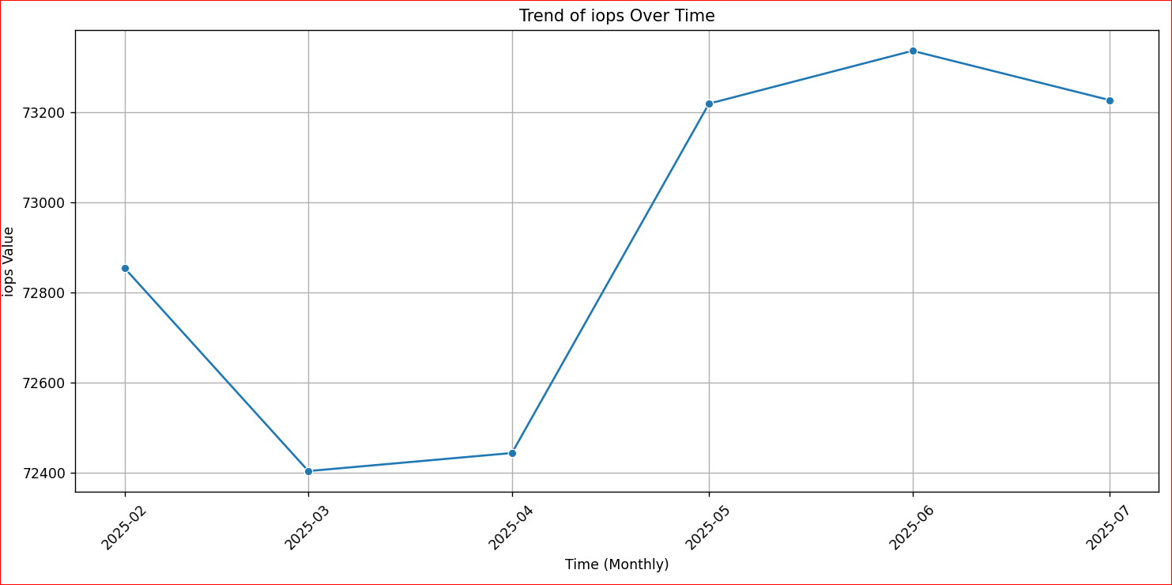
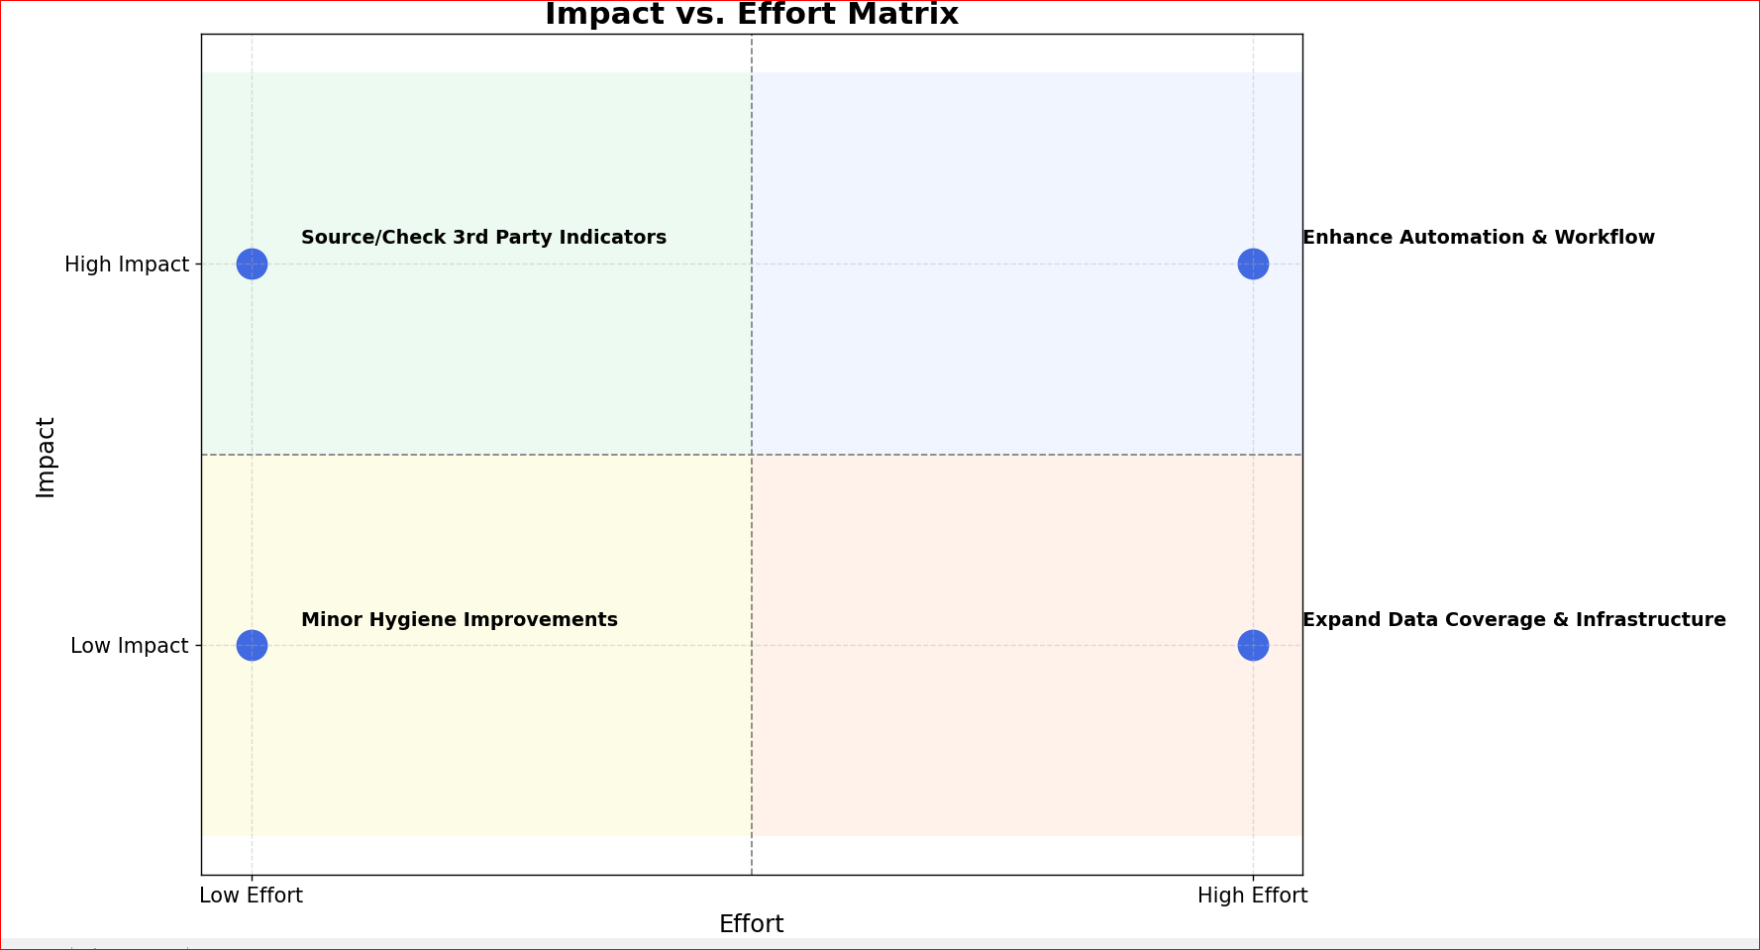
Conclusion
Identified the most influential drivers behind performance trends.
Improved data reliability through structured preprocessing and feature refinement.
Delivered actionable insights that support forecasting, operational efficiency, and long‑term strategic planning.
Provided a clear roadmap for implementation, automation, and future data expansion.
Final Takeaway
The project set out to address inconsistent data quality, limited visibility into key performance indicators, and the need for a scalable, reliable analytical framework to support better decision‑making.
This project demonstrates that with cleaner data, focused indicators, and a phased roadmap, the organization can move from reactive analysis to proactive, insight‑driven strategy.
The recommendations offer immediate wins and long‑term value, positioning the team for scalable analytics and stronger decision support.
Notes:
Let me close by bringing everything together. We began with a clear problem: inconsistent data, unclear drivers, and limited analytical scalability. Through structured analysis, feature refinement, and a phased roadmap, we now have a clearer understanding of what drives performance and how to build a more reliable, future‑ready analytics environment. The insights and recommendations presented today offer both immediate operational value and long‑term strategic impact. This work positions the organization to make smarter, faster, and more confident decisions moving forward.

Slide 11
References

